Slide 1
CSE 204 - INTRO TO Database Systems Introduction
Joseph LEDET
Department of Computer Engineering
Akdeniz University
josephledet@akdeniz.edu.tr

Slide 2
Quote of the Day
Data is not information
Information is not knowledge
Knowledge is not understanding
Understanding is not wisdom.
Clifford Stoll

Slide 3
Objectives
Some common uses of database systems.
Characteristics of file-based systems.
Problems with file-based approach.
Meaning of the term database.
Meaning of the term Database Management System (DBMS).

Slide 4
Objectives
Typical functions of a DBMS.
Major components of the DBMS environment.
Personnel involved in the DBMS environment.
History of the development of DBMSs.
Advantages and disadvantages of DBMSs.

Slide 5
Examples of Database Applications
Purchases from the supermarket
Purchases using your credit card
Booking a holiday at the travel agents
Using the local library
Taking out insurance
Renting a video
Using the Internet
Studying at university

Slide 6
File-Based Systems
Collection of application programs that perform services for the end users (e.g. reports).
Each program defines and manages its own data.

Slide 7
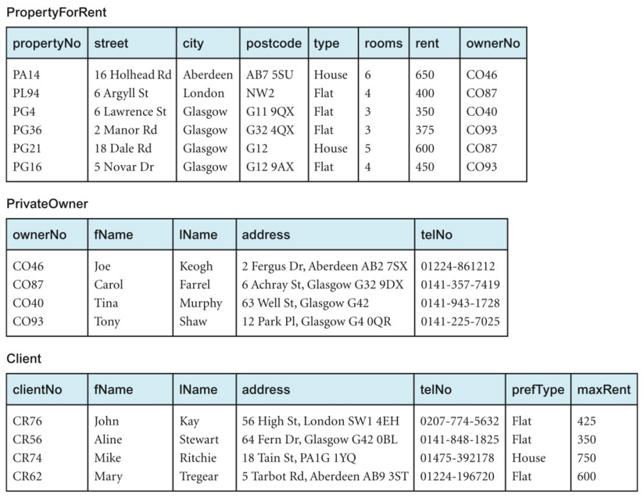
File-Based Processing

Slide 8
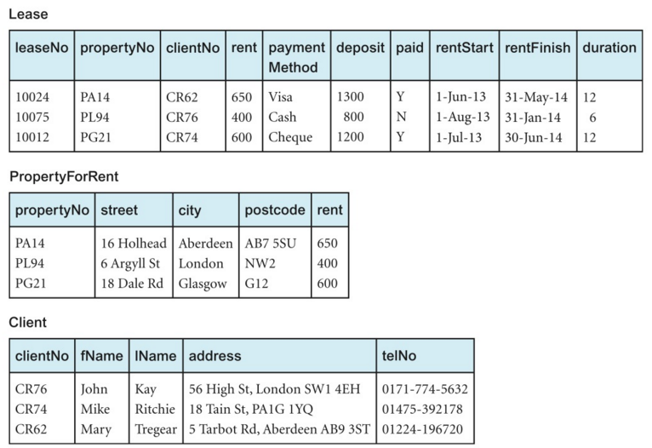
File-Based Processing

Slide 9
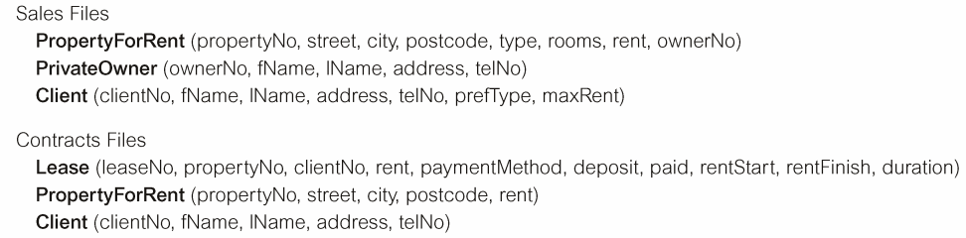
File-Based Processing

Slide 10
Limitations of File-Based Approach
Separation and isolation of data
Each program maintains its own set of data.
Users of one program may be unaware of potentially useful data held by other programs.
Duplication of data
Same data is held by different programs.
Wasted space and potentially different values and/or different formats for the same item.

Slide 11
Limitations of File-Based Approach
Data dependence
File structure is defined in the program code.
Incompatible file formats
Programs are written in different languages, and so cannot easily access each other’s files.
Fixed Queries/Proliferation of application programs
Programs are written to satisfy particular functions.
Any new requirement needs a new program.

Slide 12
Database Approach
Arose because:
Definition of data was embedded in application programs, rather than being stored separately and independently.
No control over access and manipulation of data beyond that imposed by application programs.
Result:
the database and Database Management System (DBMS).

Slide 13
Database
Shared collection of logically related data (and a description of this data), designed to meet the information needs of an organization.
System catalog (metadata) provides description of data to enable program–data independence.
Logically related data comprises entities, attributes, and relationships of an organization’s information.

Slide 14
Database Management System (DBMS)
A software system that enables users to define, create, maintain, and control access to the database.
(Database) application program: a computer program that interacts with database by issuing an appropriate request (SQL statement) to the DBMS.

Slide 15
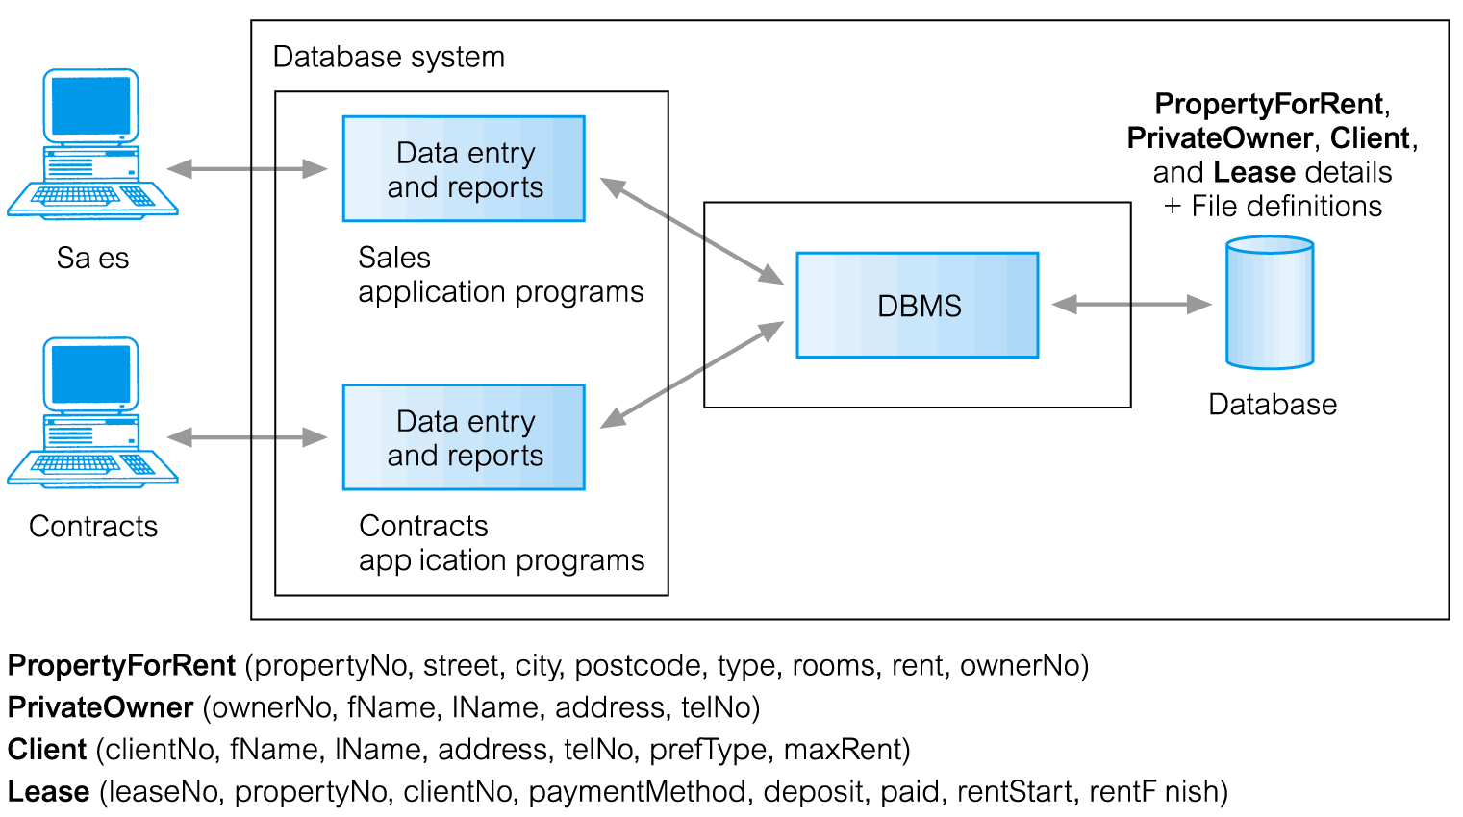
Database Management System (DBMS)

Slide 16
Database Approach
Data definition language (DDL).
Permits specification of data types, structures and any data constraints.
All specifications are stored in the database.
Data manipulation language (DML).
General enquiry facility (query language) of the data.

Slide 17
Database Approach
Controlled access to database may include:
a security system
an integrity system
a concurrency control system
a recovery control system
a user-accessible catalog.

Slide 18
Views
Allows each user to have his or her own view of the database.
A view is essentially some subset of the database.

Slide 19
Views - Benefits
Reduce complexity
Provide a level of security
Provide a mechanism to customize the appearance of the database
Present a consistent, unchanging picture of the structure of the database, even if the underlying database is changed

Slide 20
Components of DBMS Environment

Slide 21
Components of DBMS Environment
Hardware
Can range from a PC to a network of computers.
Software
DBMS, operating system, network software (if necessary) and also the application programs.
Data
Used by the organization and a description of this data called the schema.
Procedures
Instructions and rules that should be applied to the design and use of the database and DBMS.
People

Slide 22
Roles in the Database Environment
Data Administrator (DA)
Database Administrator (DBA)
Database Designers (Logical and Physical)
Application Programmers
End Users (naive and sophisticated)

Slide 23
History of Database Systems
First-generation
Hierarchical and Network
Second generation
Relational
Third generation
Object-Relational
Object-Oriented

Slide 24
Advantages of DBMSs
Control of data redundancy
Data consistency
More information from the same amount of data
Sharing of data
Improved data integrity
Improved security
Enforcement of standards
Economy of scale

Slide 25
Advantages of DBMSs
Balance conflicting requirements
Improved data accessibility and responsiveness
Increased productivity
Improved maintenance through data independence
Increased concurrency
Improved backup and recovery services

Slide 26
Disadvantages of DBMSs
Complexity
Size
Cost of DBMS
Additional hardware costs
Cost of conversion
Performance
Higher impact of a failure

Slide 27
Assignment 1
Using a language of your choice we will manipulate a file that holds information for courses. The file has the following format separated by commas
Course Department
Course Code (number)
Course Title
Course AKTS
The operations you must implement are as follows:
Get a list of courses in the file (just department and code concatenated)
Add a new course (takes the parameters above in order)
Removes a course (only takes the department and course code as parameters)
Changes the AKTS for a course (takes department, course code, and new AKTS as parameters)
Changes the course code (takes department, current course code, and new course code as parameters)

